Slide 1


Federated learning tutorial
erhtjhtyhy
Zilinghan li
Machine Learning Engineer
Data Science and Learning Division,
Argonne National Laboratory
zilinghan.li@anl.gov

Slide 2



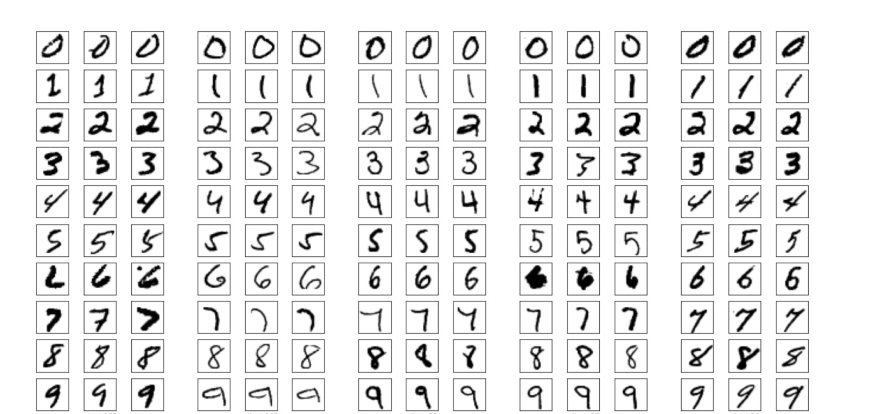





Motivation for fl – an “extreme” case
No, you cannot share private data…
I want to train a digit classifier…
central data repo

Slide 3
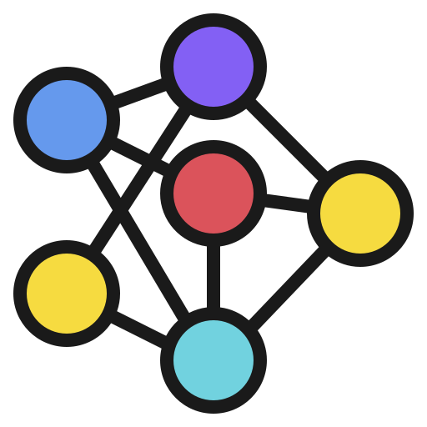
Motivation for fl – an “extreme” case
Share the model trained on local data instead of sharing the data directly
I want to train a digit classifier…
These four clients create a loose federation, and we call it federated learning (FL).

Slide 4
Motivation for fl – an “extreme” case
MNIST dataset partition: number of data samples for different labels in each client’s local datasets.
Training a CNN by sharing model parameters trained locally (i.e. using federated learning) can get >95% accuracy!

Slide 5
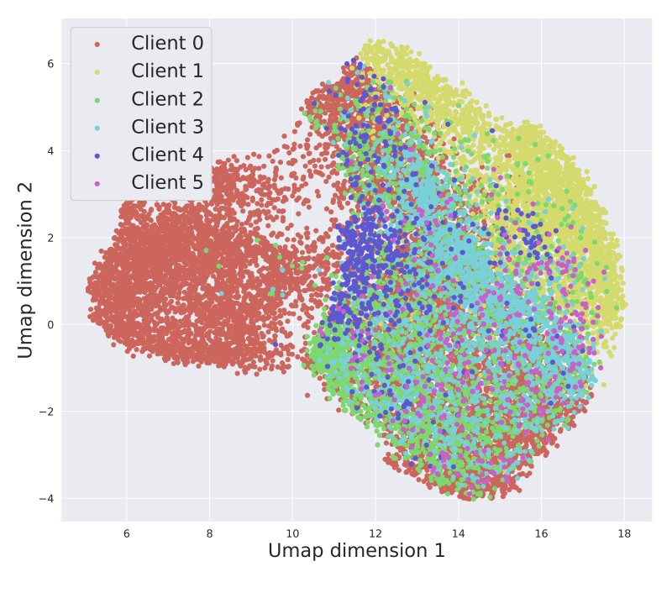
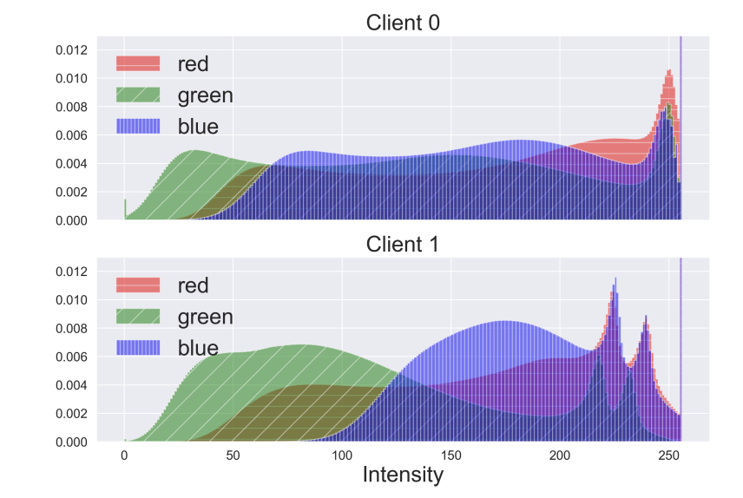
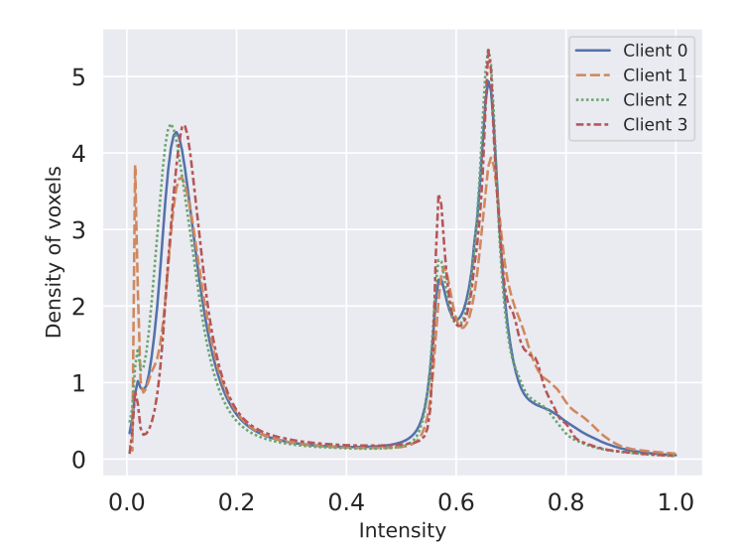
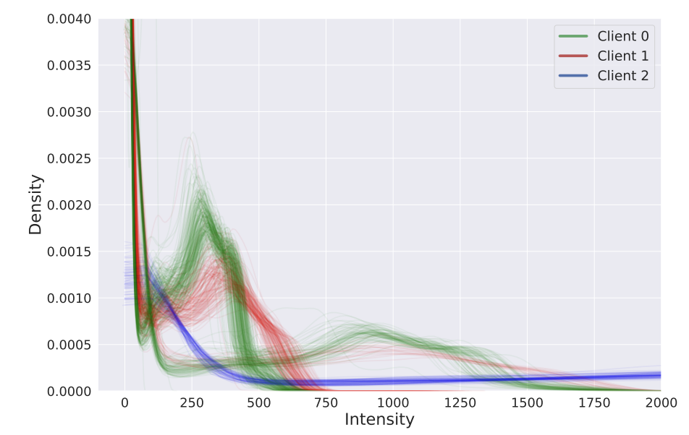
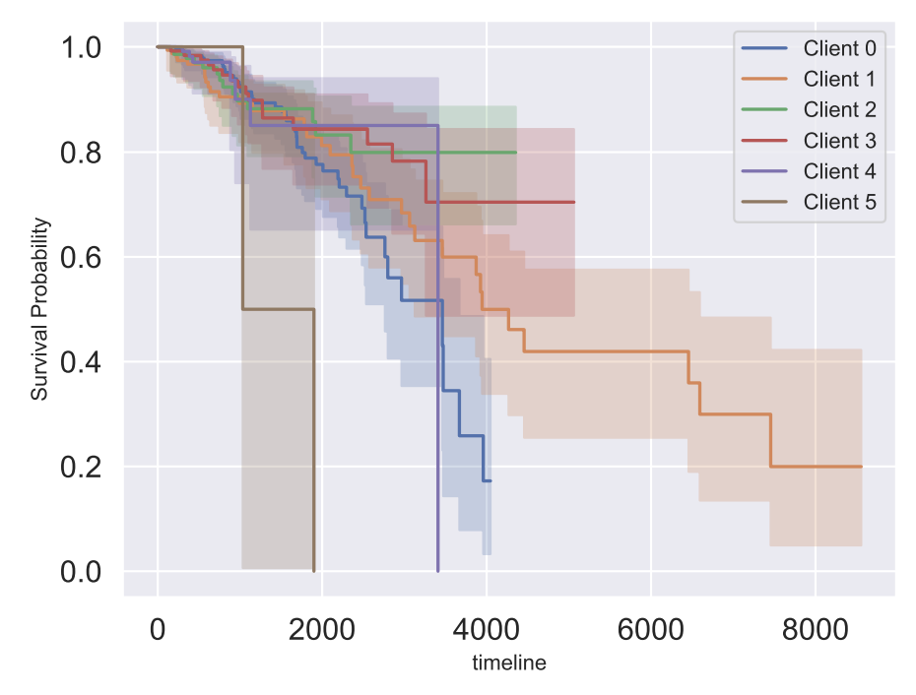
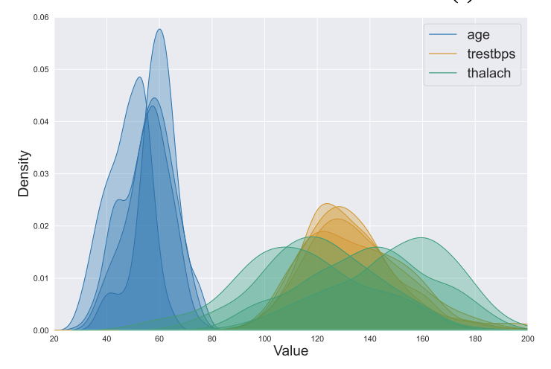
Motivation – any more real reasons?
This example is trivial and does not sound like something will happen in real life…
So, again, why federated learning?
In real world, it is common that the data at different data silos have different distributions, especially in domains such as biomedicine where data privacy is important. The biomedicine data can be very heterogeneous due to different population distributions, device variations, data collection protocol differences, etc.
Ogier du Terrail, Jean, Samy-Safwan Ayed, Edwige Cyffers, Felix Grimberg, Chaoyang He, Regis Loeb, Paul Mangold et al. "Flamby: Datasets and benchmarks for cross-silo federated learning in realistic healthcare settings." Advances in Neural Information Processing Systems 35 (2022): 5315-5334.

Slide 6

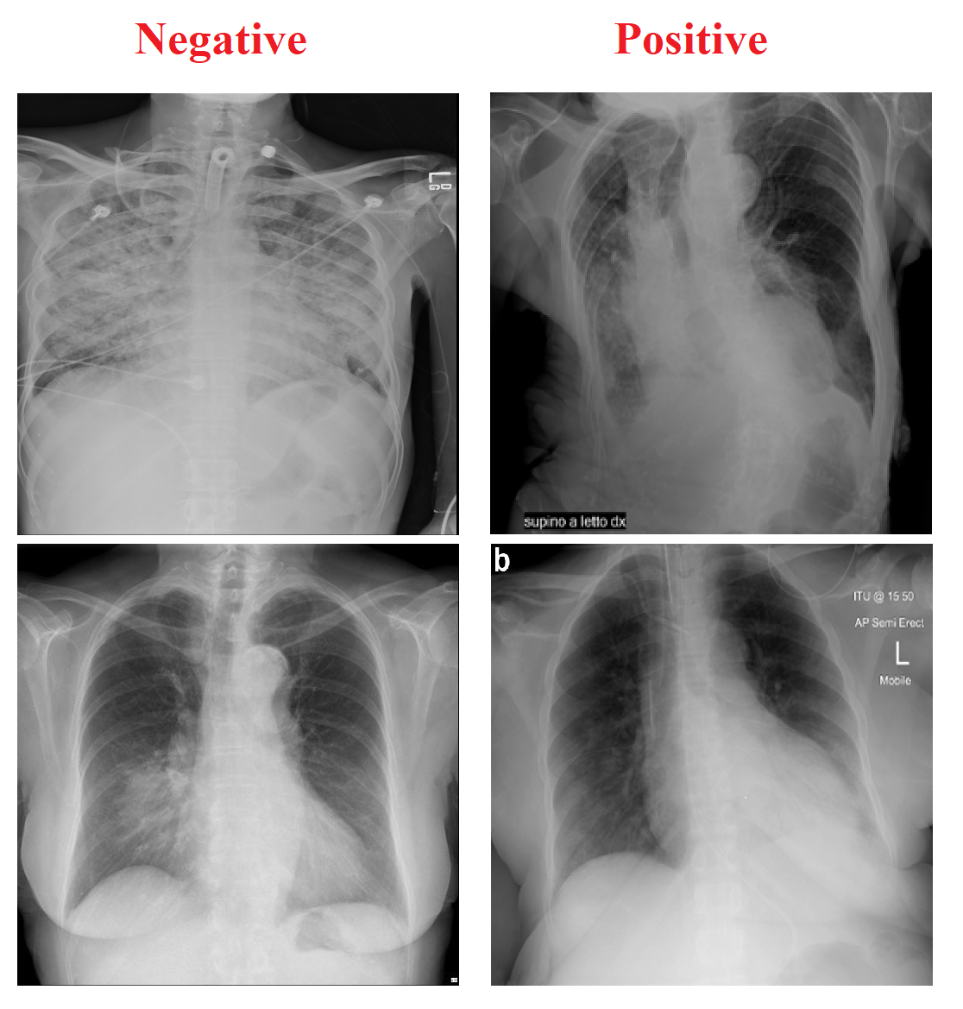

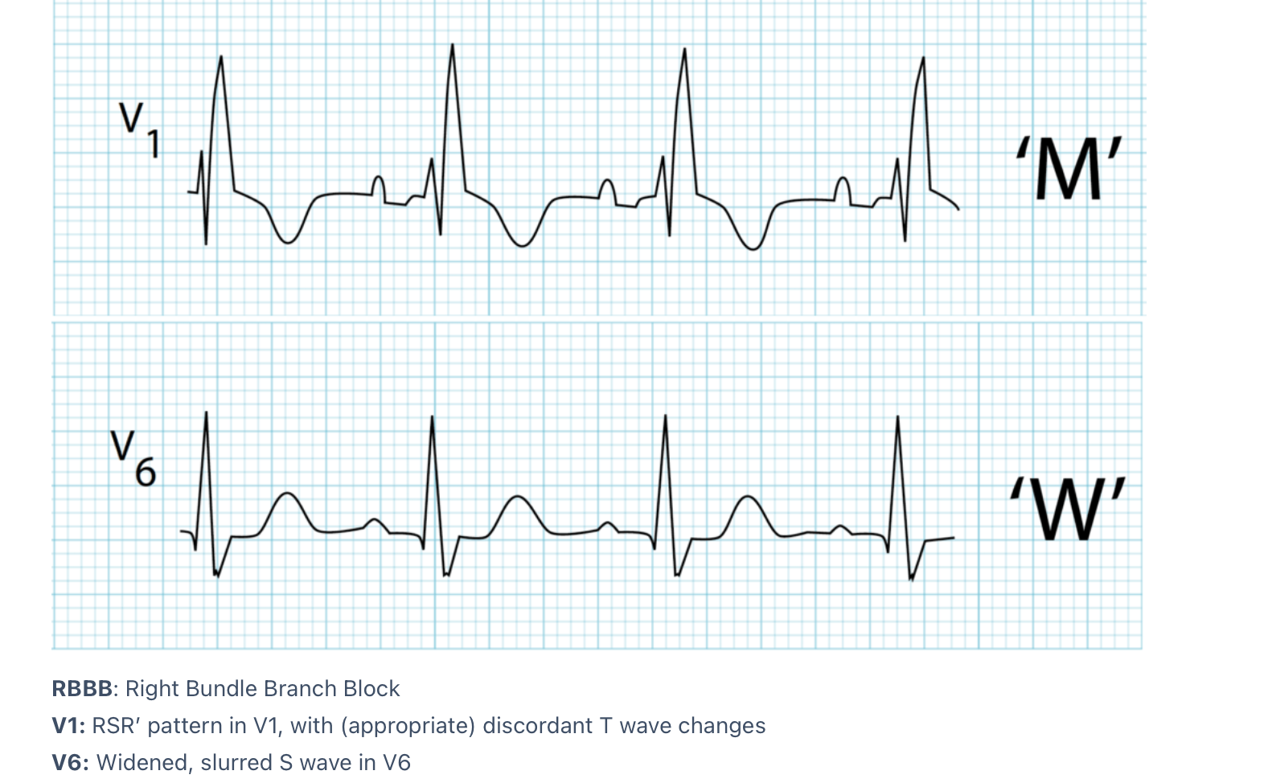
Motivation – any more real reasons?
In biomedical research, access to many types of data, such as identifiable electronic health records (HER), medical images, and electrocardiogram (ECG) readings, is strictly regulated by law like HIPAA in the United States and GDPR in the European Union. Data access committees and institutional review boards (IRB) manually manage access controls to ensure that research is ethical and that the privacy of research subjects is safeguarded.
Historically, these necessary, but cumbersome, access restrictions have had the undesirable effect of siloing data at the host institution which in turn has stymied collaborative research.
Privacy Concerns in
Biomedical Data

Slide 7


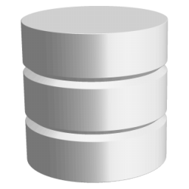


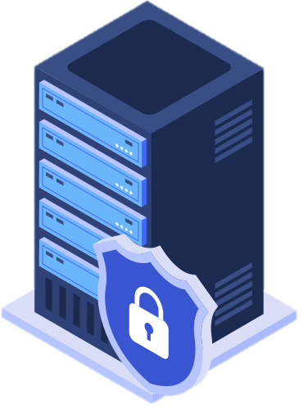

Federated learning
Client 3
Client 2
Client 4
Server
Client 1

Slide 8
Hands on tutorial
A Case Study on the AI-READI Dataset
From the previous tutorial, we saw that the AI-READI dataset contains images from four different types of devices .
topcon_triton
optomed_aurora
topcon_maestro2
icare_eidon

Slide 9
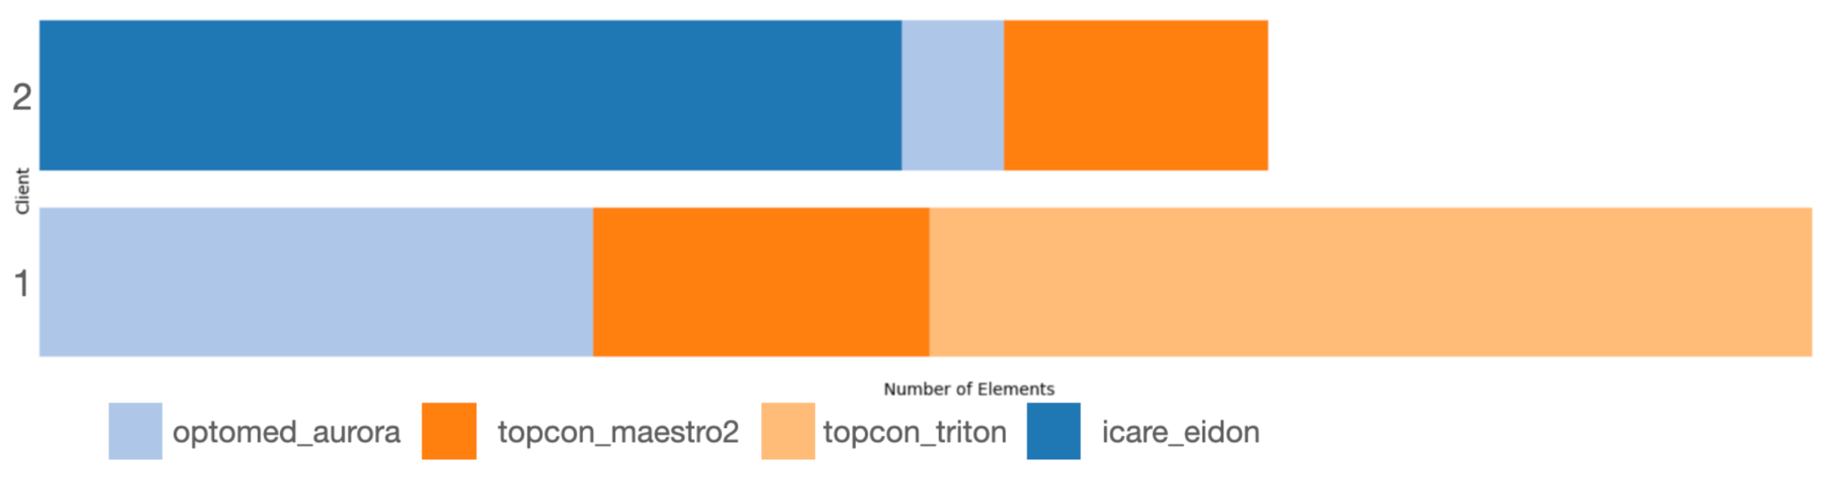
Hands on tutorial
A Case Study on the AI-READI Dataset
Now Let’s consider we have 2 hospitals with data distribution as below:
Hospital 1 (Client 1) has only the following device types:
topcon_triton
optomed_aurora
topcon_maestro2
Hospital 2 (Client 2) has only the following device types:
icare_eidon
optomed_aurora
topcon_maestro2

Slide 10
Hands on tutorial
A Case Study on the AI-READI Dataset
If we train our model solely on data from one hospital, which includes only a subset of device types.
The model may not generalize well to unseen devices.
For example, if a hospital later adds a new device type that wasn't present in its training data (but exists in another hospital), the model may fail to properly recognize or classify its outputs.

Slide 11
Hands on tutorial
A Case Study on the AI-READI Dataset
Now, Let’s get everyone divided into groups of 3.
Each person in the group can open one of the following three notebooks.
APPFL_Server_AI_READI.ipynb
APPFL_Client1_AIREADI.ipynb
APPFL_Client2_AIREADI.ipynb

Slide 12

Hands on tutorial
A Case Study on the AI-READI Dataset
Step 1: Train a model using each client’s local data.
APPFL_Client1_AIREADI.ipynb
APPFL_Client2_AIREADI.ipynb
Train a model independently
Train a model independently

Slide 13
Hands on tutorial
A Case Study on the AI-READI Dataset
Step 2: Federated training of a model with two clients
APPFL_Server_AI_READI.ipynb
(1) Spins up the server
APPFL_Client1_AIREADI.ipynb
APPFL_Client2_AIREADI.ipynb
(2) Train model locally
(3) Send aggregation request
(2) Train model locally
(3) Send aggregation request

Slide 14
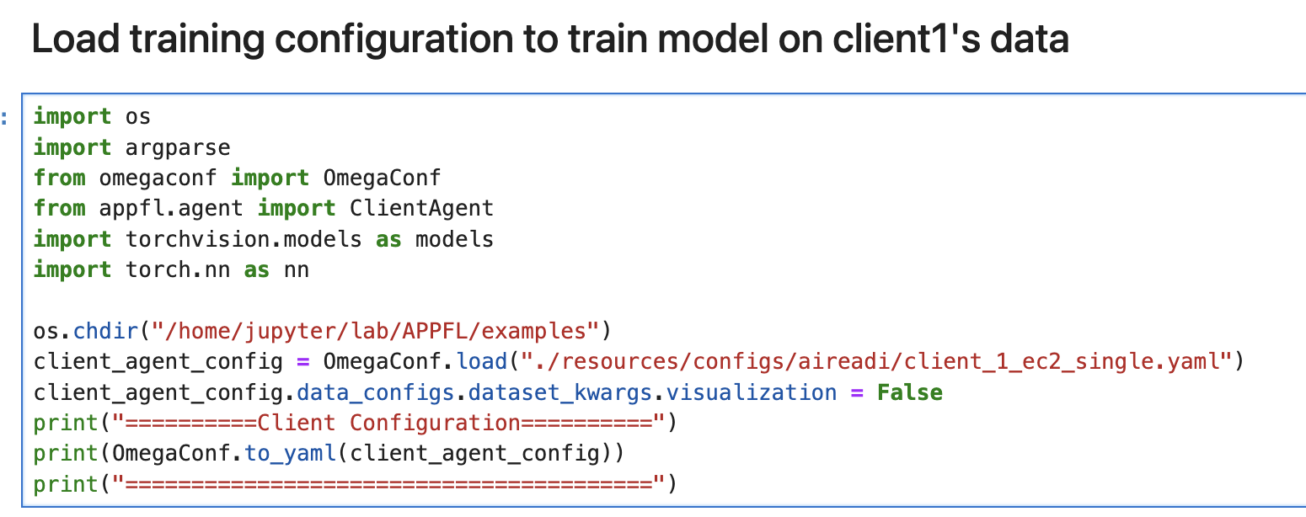
Hands on tutorial
A Case Study on the AI-READI Dataset
For the two clients, open your notebook, and let’s first train a classification model using your “local data” only.
In client notebooks lets run the first cell.

Slide 15
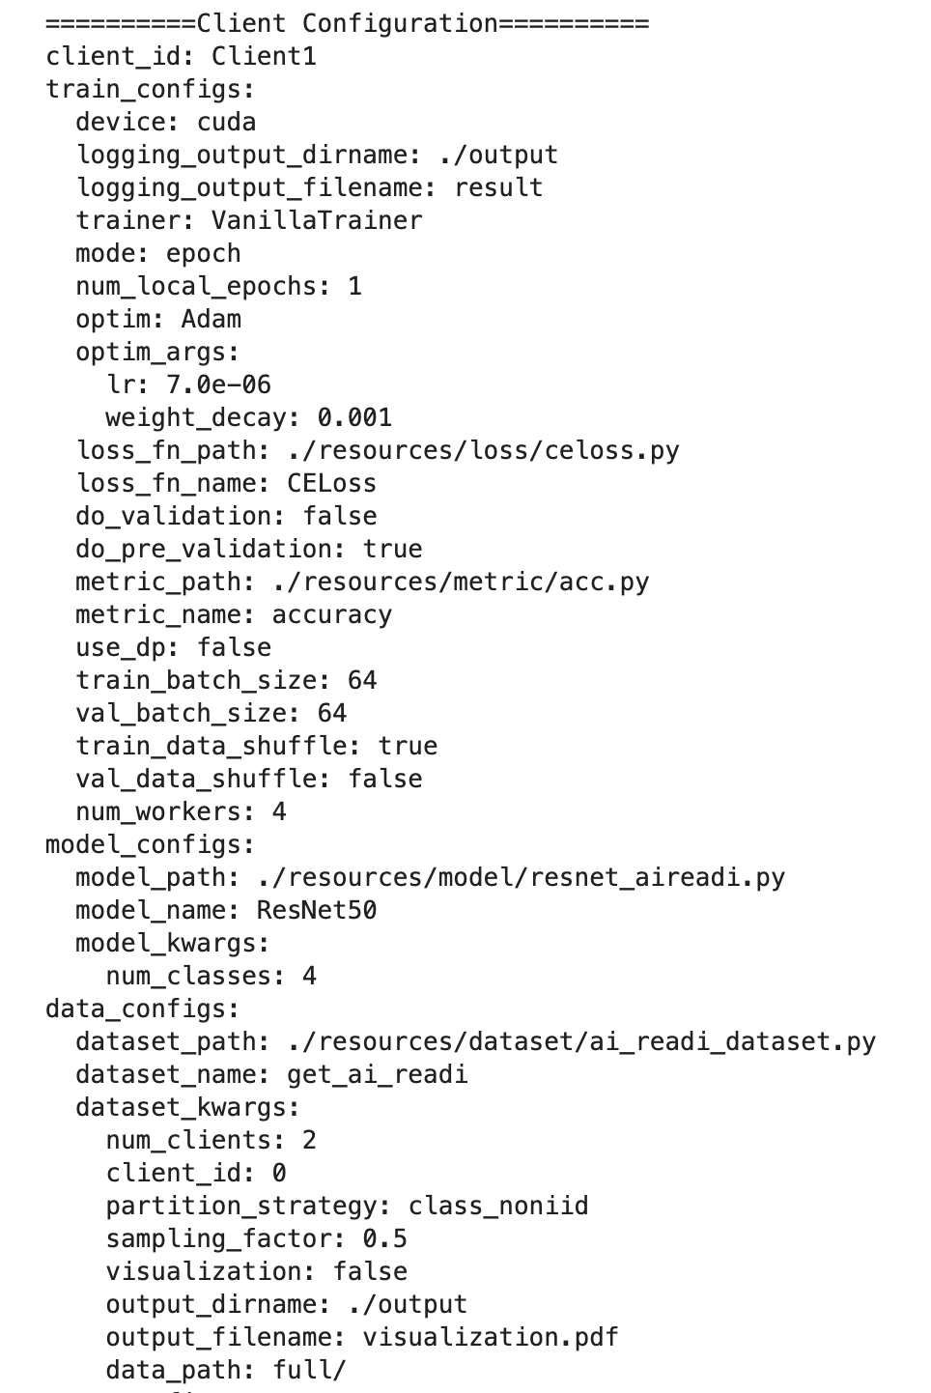
Hands on tutorial
A Case Study on the AI-READI Dataset
The training configurations will be printed.

Slide 16
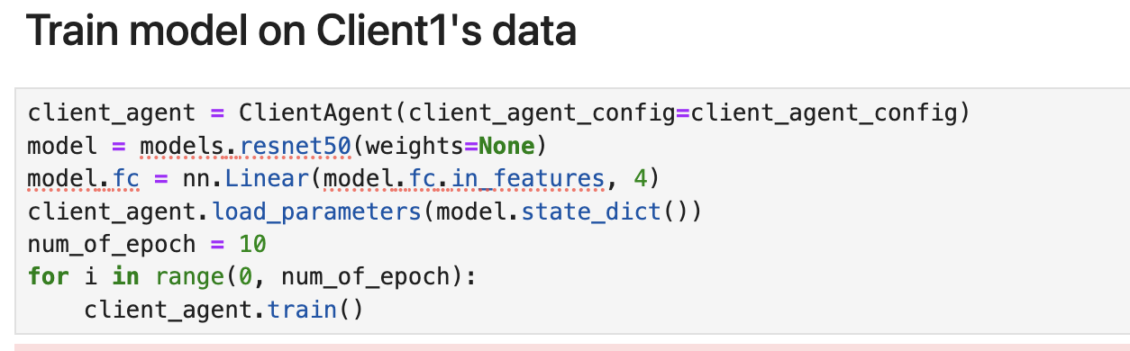
Hands on tutorial
A Case Study on the AI-READI Dataset
Run Cell 2 on both clients’ notebook to launch local training for 10 epochs.

Slide 17
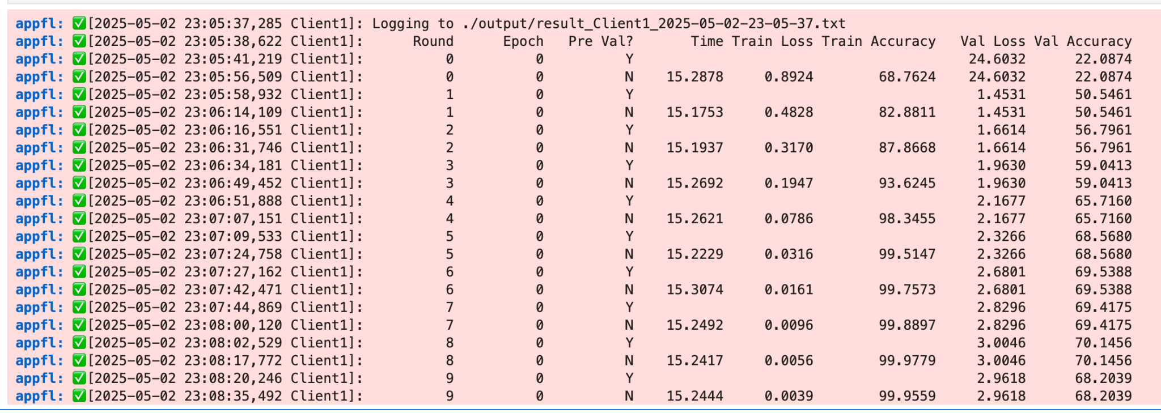
Hands on tutorial
A Case Study on the AI-READI Dataset
We can see that the accuracy stays around 70%, which is not good as we expect.

Slide 18


Hands on tutorial
A Case Study on the AI-READI Dataset
Now, let’s try to leverage federated learning to have two hospitals to collaboratively train a more robust and generalized model that can predict all four device types.
In this tutorial, we will leverage the Advanced Privacy-Preserving Federated Learning (APPFL) an open-source framework to launch a federated learning client for running a federated learning experiment with two clients and one central server.

Slide 19
Hands on tutorial
A Case Study on the AI-READI Dataset
Let’s leave our client notebooks now and move on to the server notebook.
Now the member of the group who is designated as server will run their notebook.
Two clients need to keep their notebooks but don’t run it yet. – We need to first spin up the server.

Slide 20
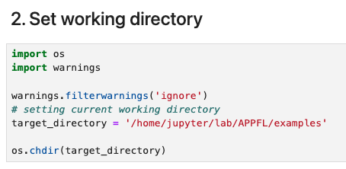
Hands on tutorial
A Case Study on the AI-READI Dataset
We will run cells of server notebook
First, since we have pre-installed the APPFL module for you we don’t have to run anything.
Second, We just set the working directory for our code.

Slide 21
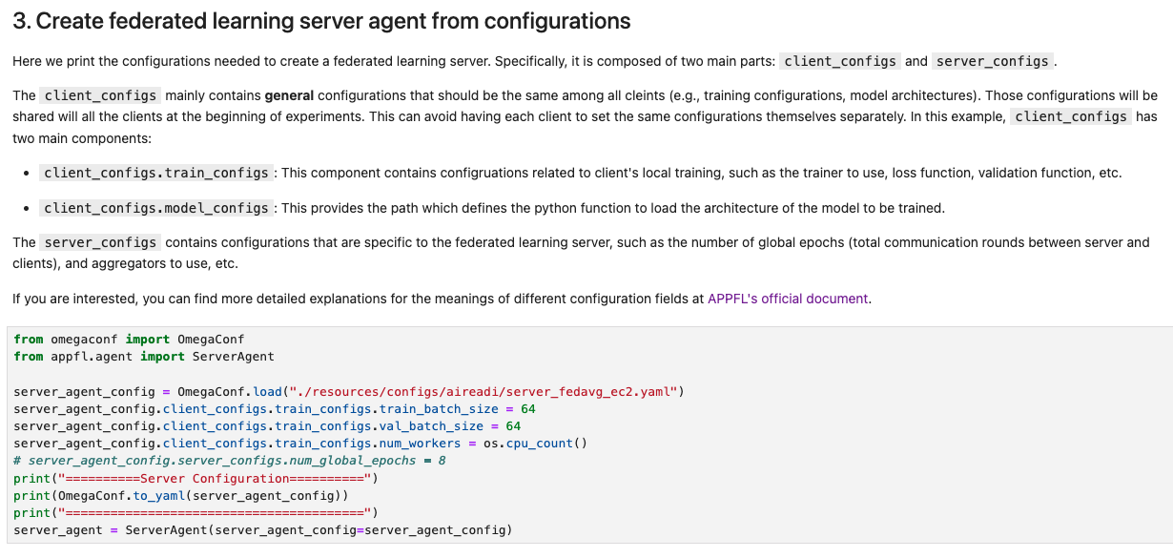
Hands on tutorial
A Case Study on the AI-READI Dataset
Now, let’s launch the server agent with configurations.

Slide 22
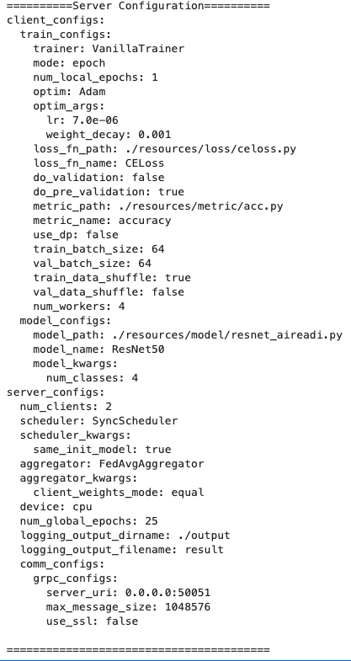
Hands on tutorial
A Case Study on the AI-READI Dataset
Training settings
Model: ResNet50
Optimizer: Adam
Learning Rate: 7e-6
Weight Decay: 1e-3
Loss Function: Cross-Entropy
Federated Learning settings
Number of clients: 2
Epoch per client: 25
Federated Averaging Aggregator training with synchronous model update
gRPC for communication between the client and server sending requests

Slide 23
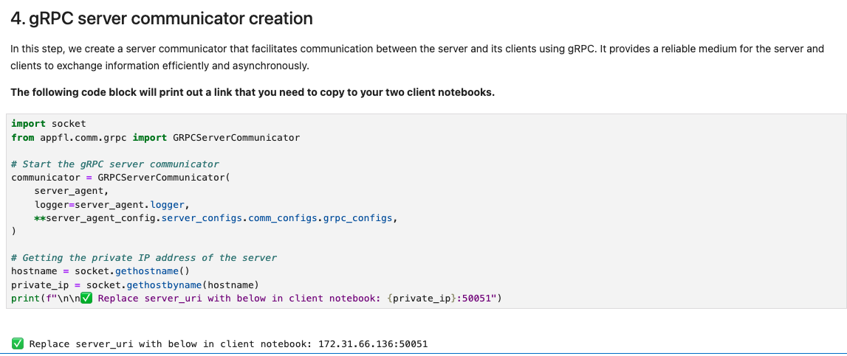
Hands on tutorial
A Case Study on the AI-READI Dataset
Now we need to define a server communicator to facilitate the communication between the server and two other clients.
Share the output URI from this cell to the other members of the group that have client notebooks open.

Slide 24
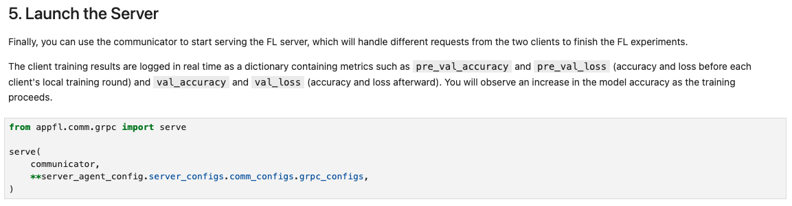
Hands on tutorial
A Case Study on the AI-READI Dataset
Finally, run the last cell to start serving.
Hooray! Your server is up and running now. Now we move on to Client Notebooks

Slide 25
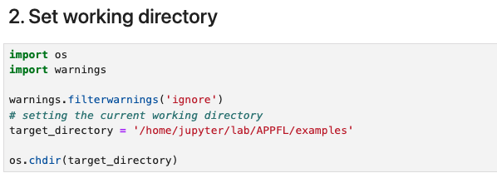
Hands on tutorial
A Case Study on the AI-READI Dataset
Now let’s go back to client notebooks
First two steps are same as server we will install APPFL package and then set the working directory.

Slide 26
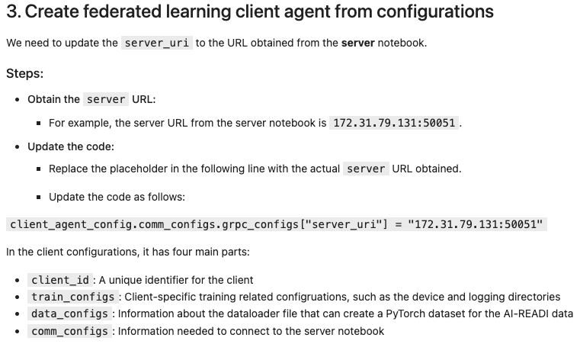
Hands on tutorial
A Case Study on the AI-READI Dataset

Slide 27
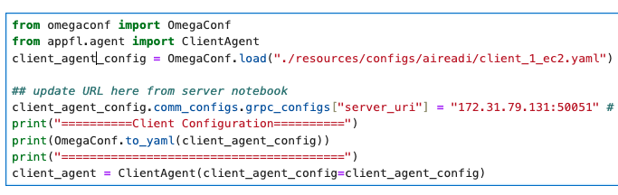
Hands on tutorial
A Case Study on the AI-READI Dataset
Remember to replace server_uri with the output from server notebook before running this cell
If you forgot, it’s ok you can put the server url and re-run the cell

Slide 28
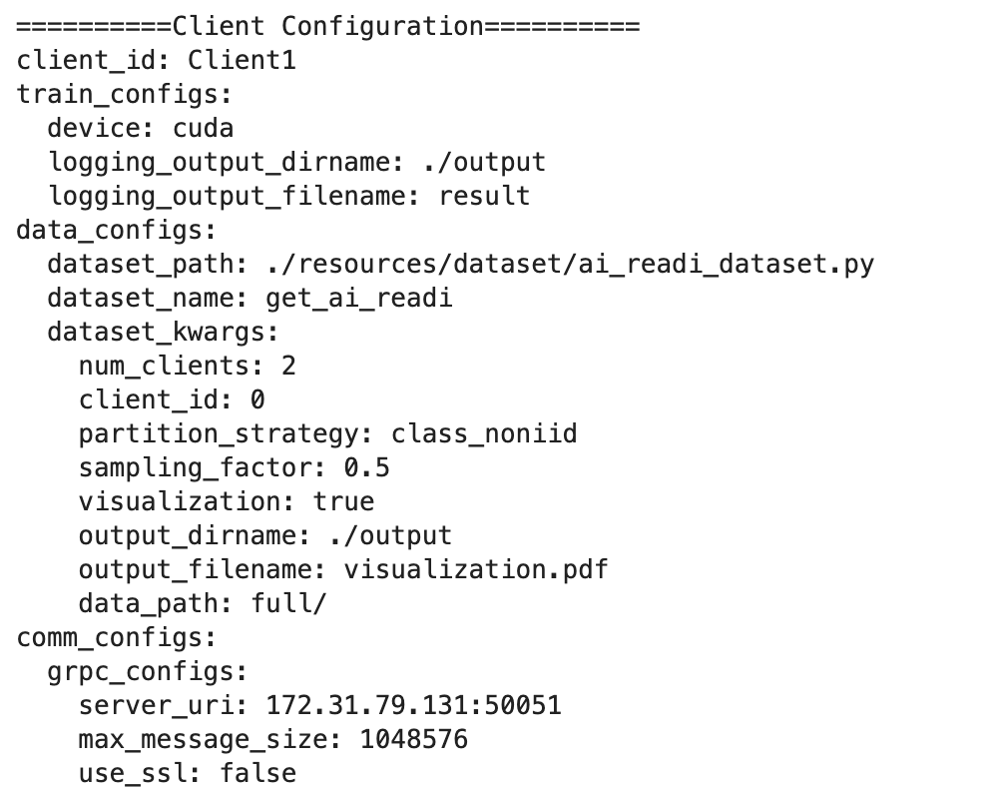
Hands on tutorial
A Case Study on the AI-READI Dataset
Client configurations will be printed.

Slide 29
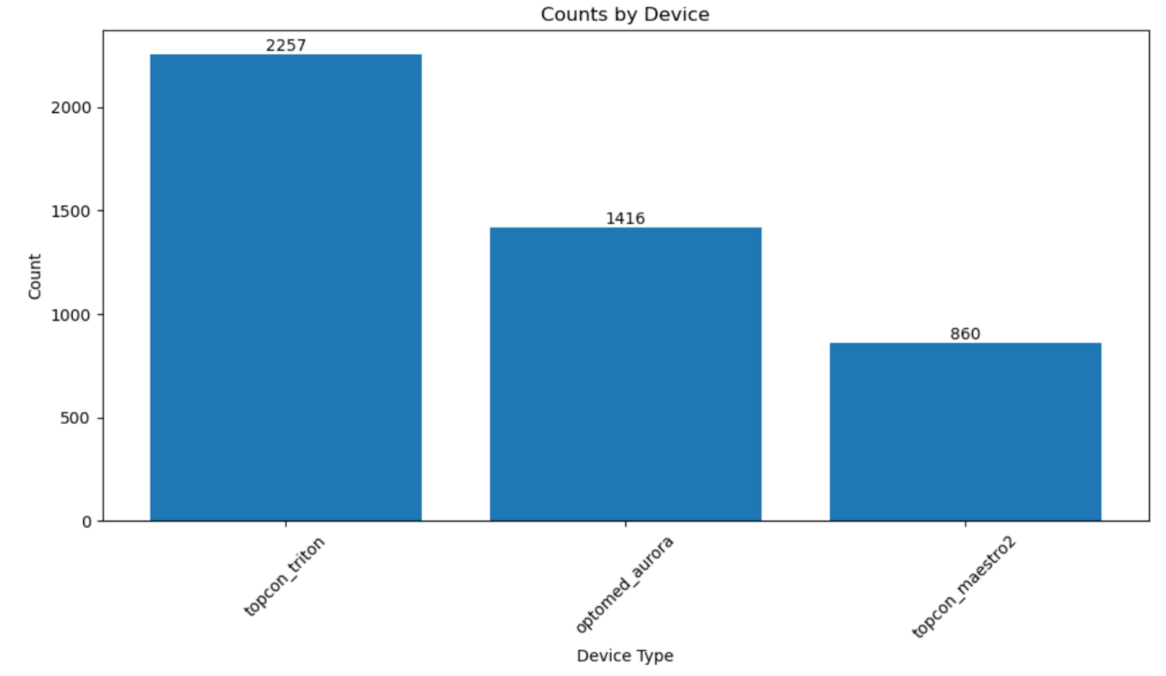
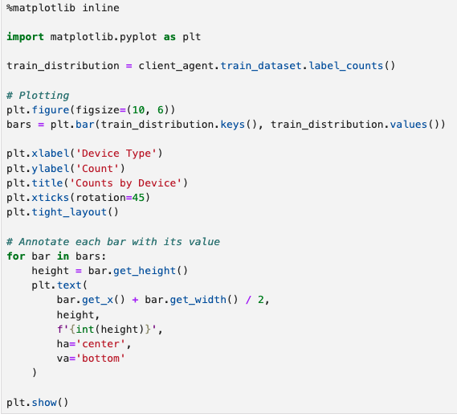
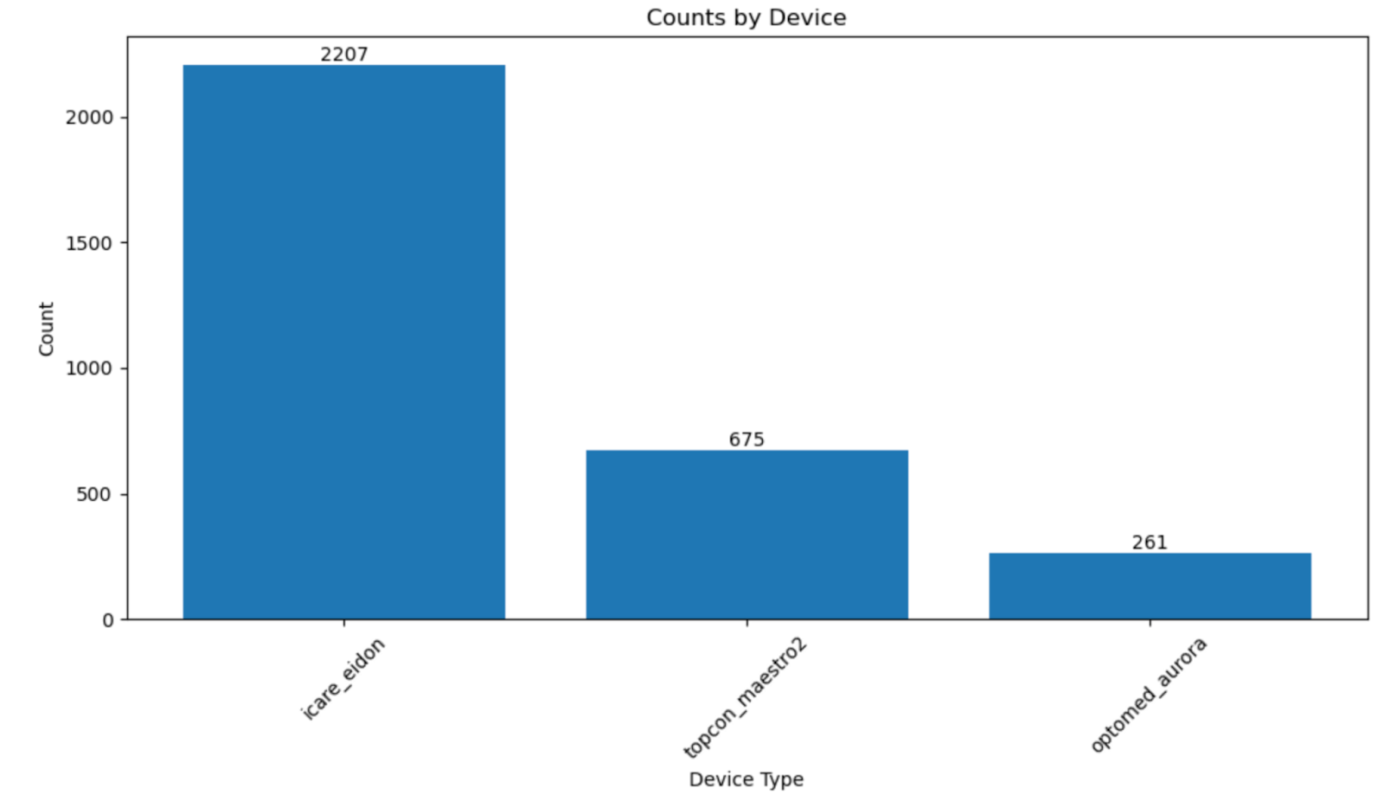
Hands on tutorial
A Case Study on the AI-READI Dataset
Now, let’s visualize the data distribution for each client before starting FL process.

Slide 30
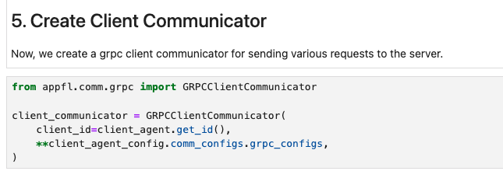
Hands on tutorial
A Case Study on the AI-READI Dataset
Create client communicator to send various requests to FL server via gRPC.

Slide 31
Hands on tutorial
A Case Study on the AI-READI Dataset
Start the training loop.
In this main training loop, there are four main types of request to send to the server:
(1) get_configuration(): Get general client configurations for local training
(2) get_global_model(init_model=True): Get the initial global model for training
(3) update_global_model(): Send the trained local model to update the global model, and get the updated model back for further local training
(4) invoke_custom_action(action="close_connection"): Close the connection with the server

Slide 32
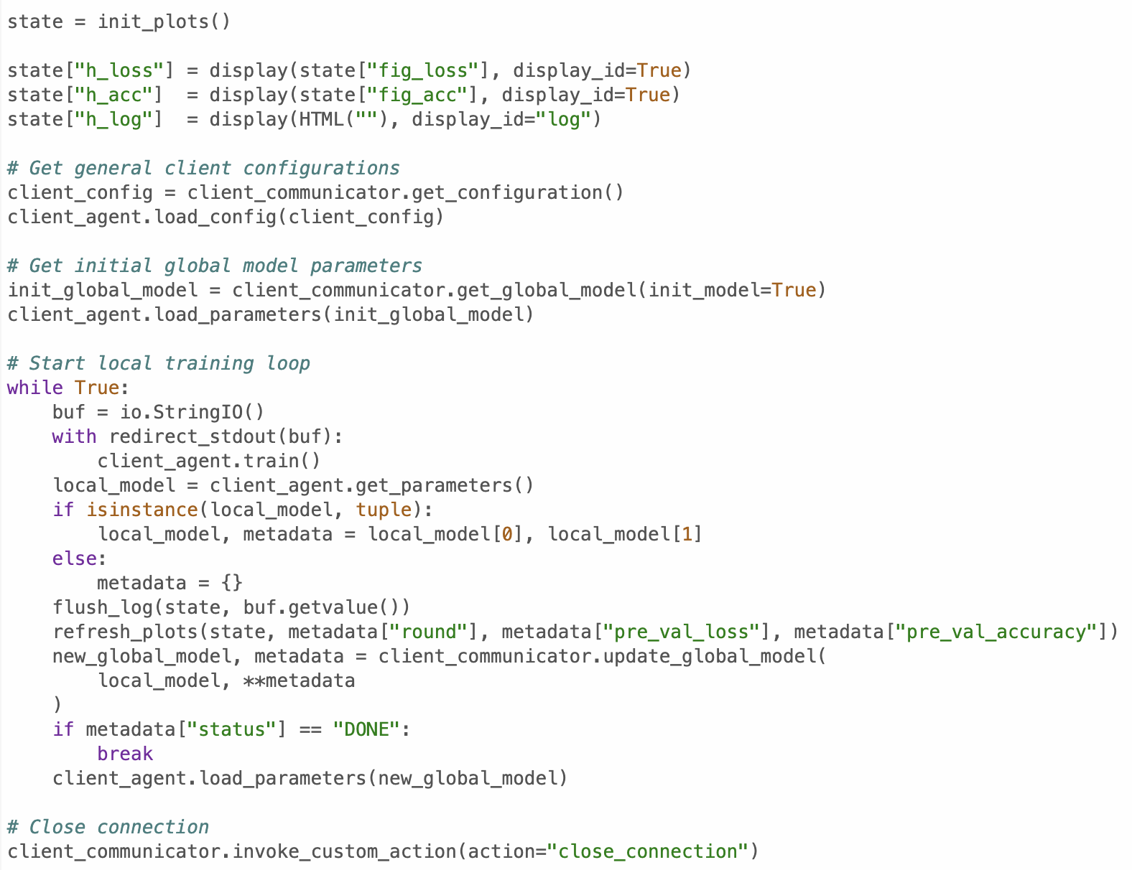
Hands on tutorial
A Case Study on the AI-READI Dataset

Slide 33
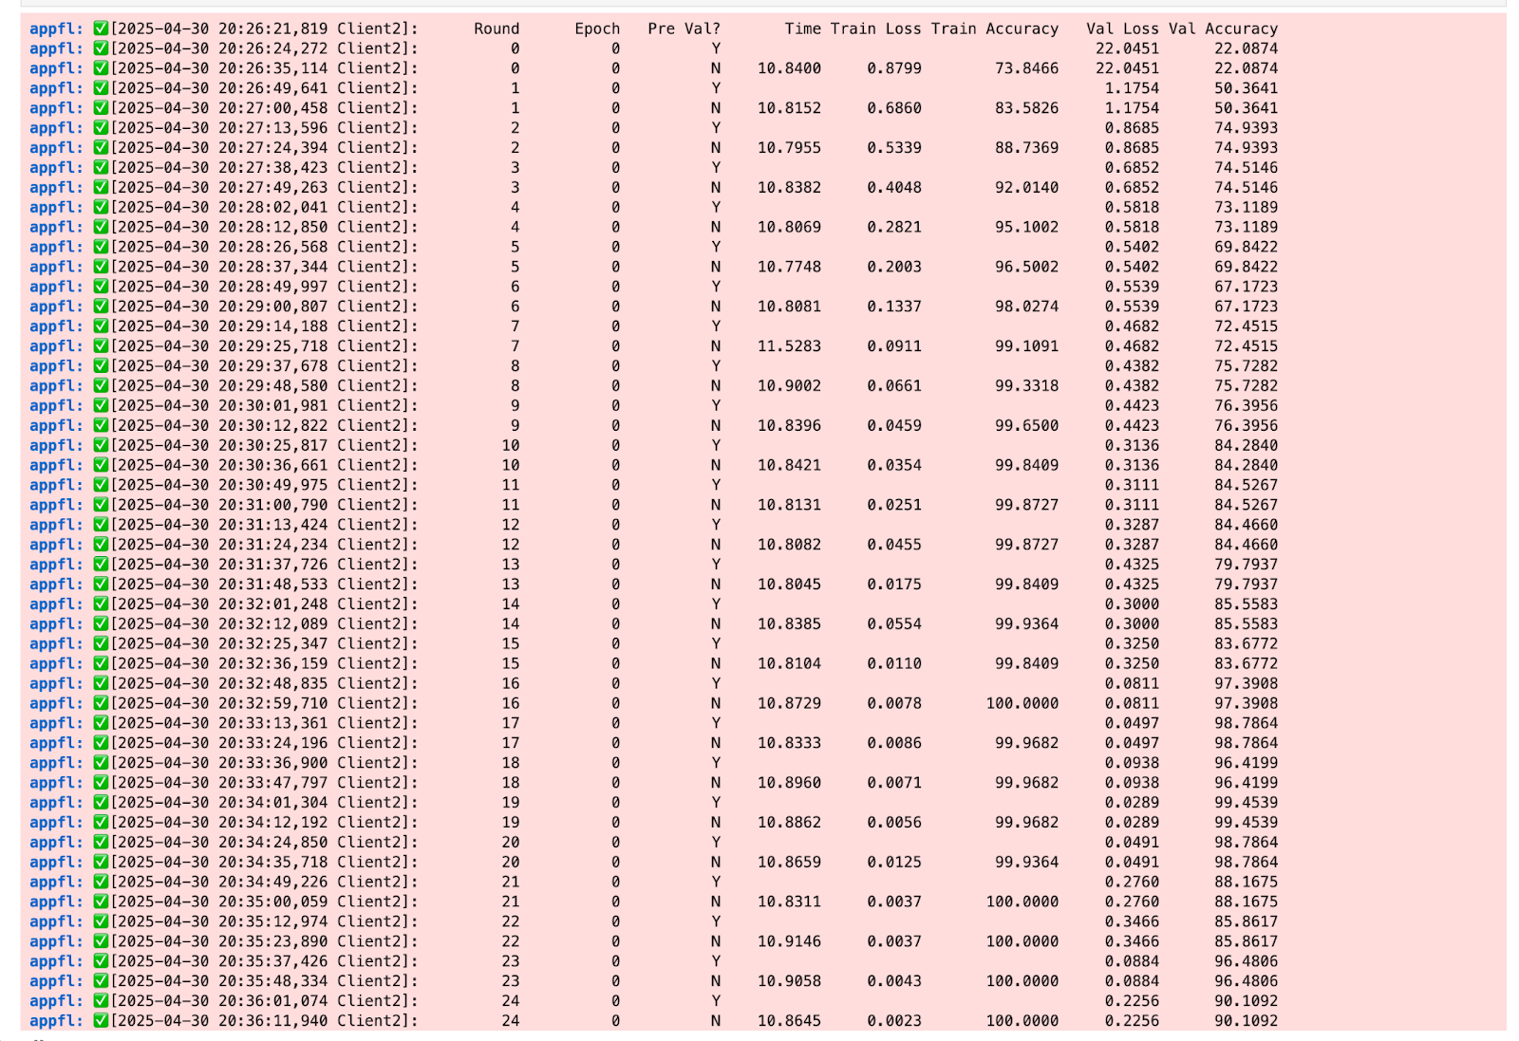
Hands on tutorial
A Case Study on the AI-READI Dataset
Client notebook’s training outputs.

Slide 34
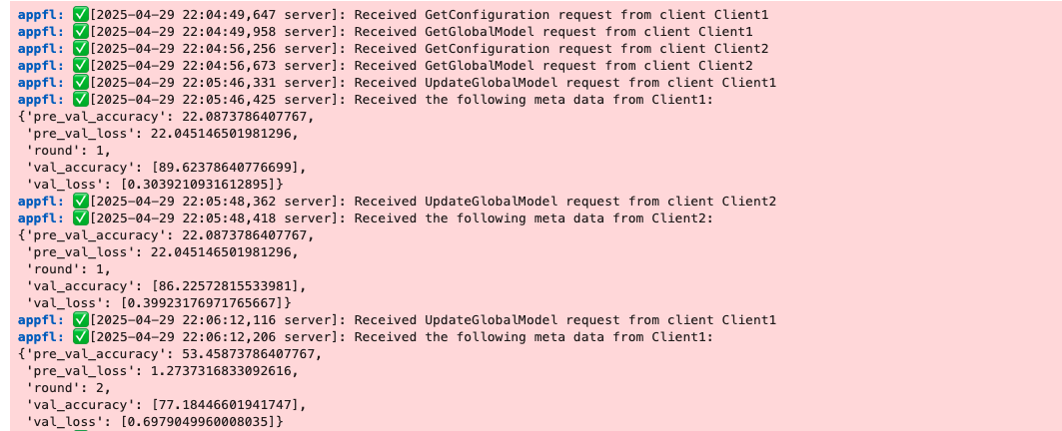
Hands on tutorial
A Case Study on the AI-READI Dataset
Server notebook’s training outputs.

Slide 35
Hands on tutorial
A Case Study on the AI-READI Dataset
From the results, we can see that the accuracy goes more than 90 and the model is able to identify the device with much higher accuracy compared to locally trained models.
You can go check out all the notebooks from today here: https://github.com/AdioosinUIUC/aireadi-course

